Slide 1
Introduction to Reinforcement Learning
LARK Lab RL Reading Seminar Week 1
March 18, 2025
Slides will be available on github repo

Slide 2
Why Reinforcement Learning (RL)
A Classical Yet Trending Field
Why This Book?
Why RL Matters for You?
Why This Seminar?

Slide 3
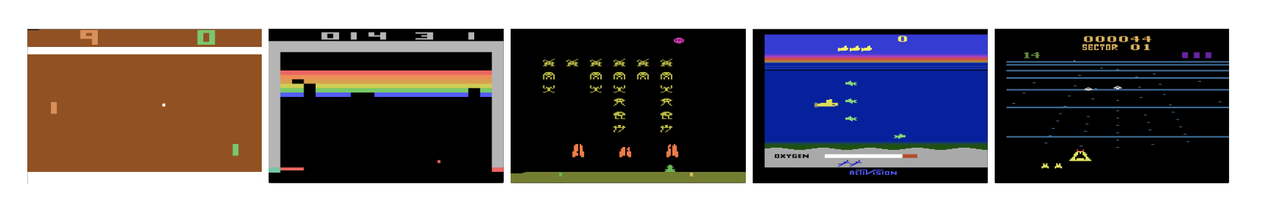
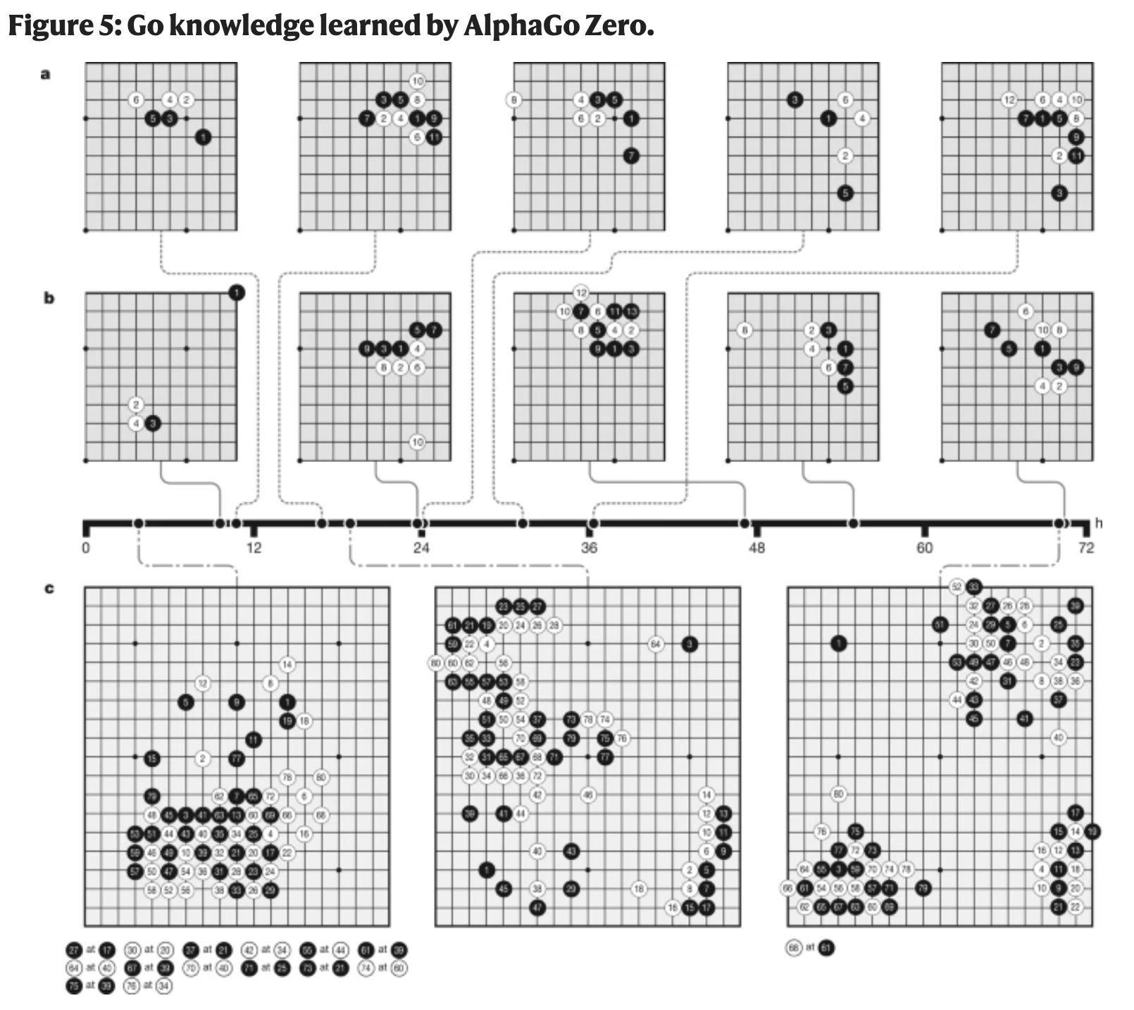
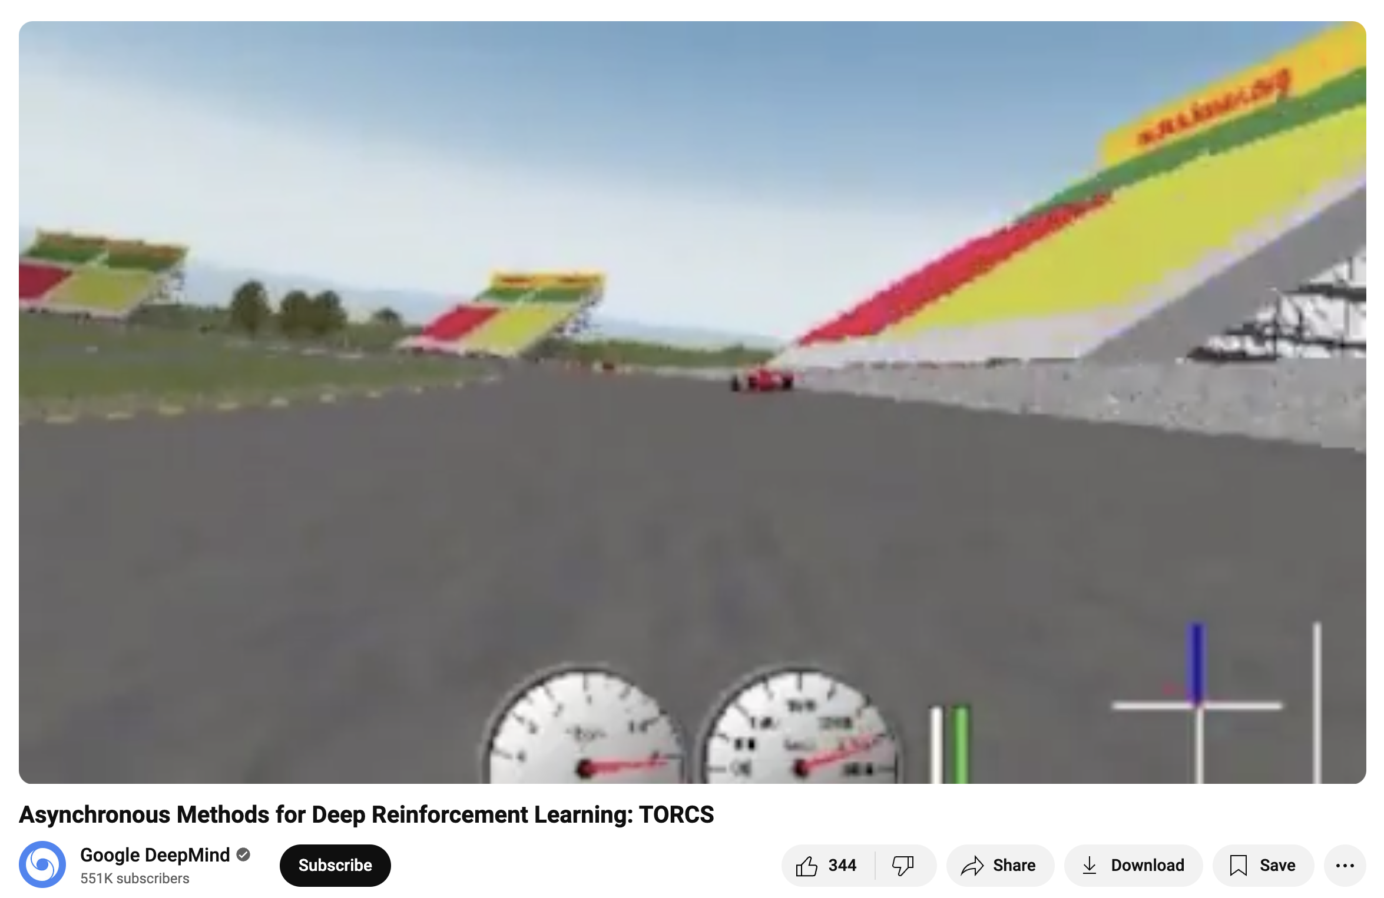
A Classical Yet Trending Field
Q Learning (Chap 6)
Mnih, Volodymyr, et al. "Playing Atari with Deep Reinforcement Learning.” 2013. (Deep Q Learning)
Tabular Rasa (Chap 6, not exact name)
Policy Gradient Methods (Chap 13)
Silver, David, et al. "Mastering the game of go without human knowledge." Nature 2017 (AlphaGo Zero)
Mnih, Volodymyr, et al. "Asynchronous methods for deep reinforcement learning." ICML, 2016. (A2C and A3C)

Slide 4
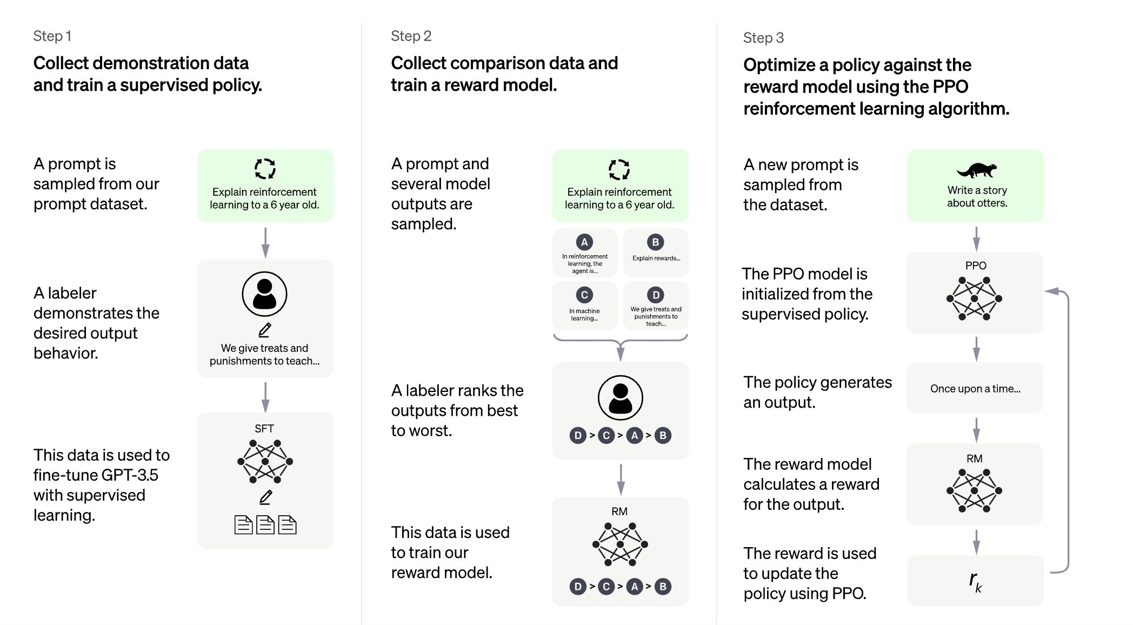
A Classical Yet Trending Field
OpenAI. Reinforcement Learning from Human Feedback. 2022

Slide 5
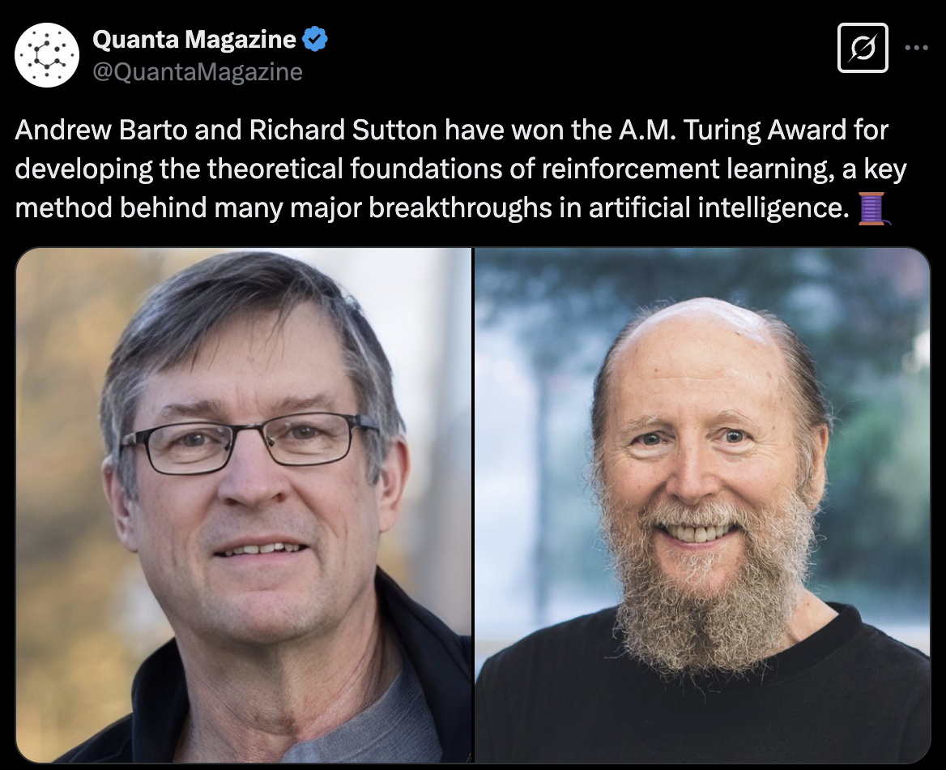
Why This Book?

Slide 6
Why This Book?
A classical yet timeless read
Written before deep learning and LLM era, this books remains one of the most fundamental resources on reinforcement learning
Many modern advancements (like RLHF in ChatGPT) build on the principles outlined in this book.
This book emphasizes first principles—understanding RL from the ground up rather than just applying existing libraries
Reading it provides a rigorous foundation for both academic and industry applications.

Slide 7

Why RL Matters for You?
Reading this book is as important as having a PhD!

Slide 8
Why RL Matters for You? -- It Does Not!
Unless --
You want to work in AI/ML – RL is a core topic in AI job interviews and technical assessments. (Like LSTM&CNN in 2016-2018; transformers in 2019-now)
You’re interested in AI advancements – RL powers innovations like AlphaGo, robotics, and RLHF in LLMs.
You enjoy solving real-world decision-making problems – RL is used in healthcare, finance, and beyond.

Slide 9
Why This Seminar?
You seek to understand the true essence behind RL equations – The math behind RL captures core ideas of optimization, probability, and sequential decision-making.
You are fascinated by how AI agents truly learn and adapt – RL models how decisions are made under uncertainty, a fundamental aspect of intelligent behavior.
You want to dive deep into the foundations of AI – RL provides a fundamental framework for autonomous learning and control.

Slide 10
What we will cover in the next few weeks
Introduction to Reinforcement Learning – Understanding agents, environments, rewards, and policies.
Multi-Armed Bandits – The simplest form of RL, balancing exploration vs. exploitation.
Markov Decision Processes (MDPs) – The mathematical foundation of RL
Dynamic Programming – Solving MDPs with value iteration and policy iteration.
Monte Carlo Methods – Learning from experience without a model of the environment.
The Five Core Chapters!

Slide 11
What we hope to cover – classical but advanced algorithms
Q-learning and Deep Q Learning
REINFORCE
Advantage Actor-Critic (A2C)
If time permits …

Slide 12
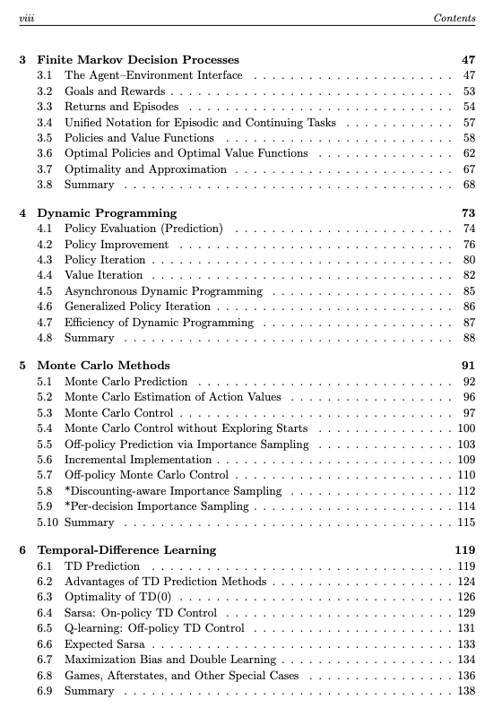
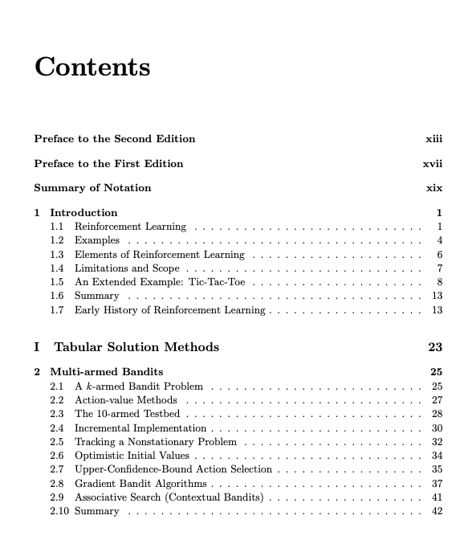

Slide 13
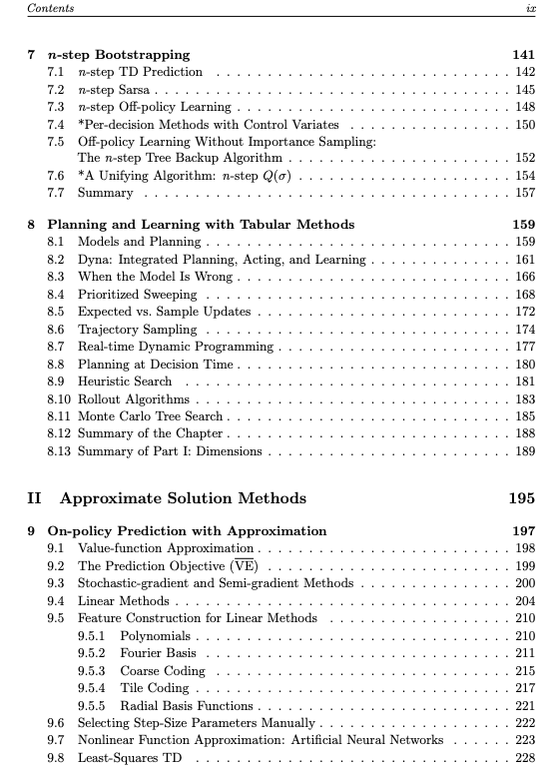
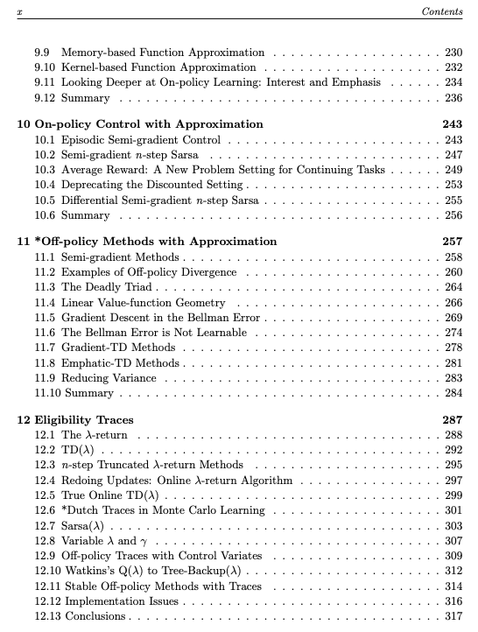

Slide 14
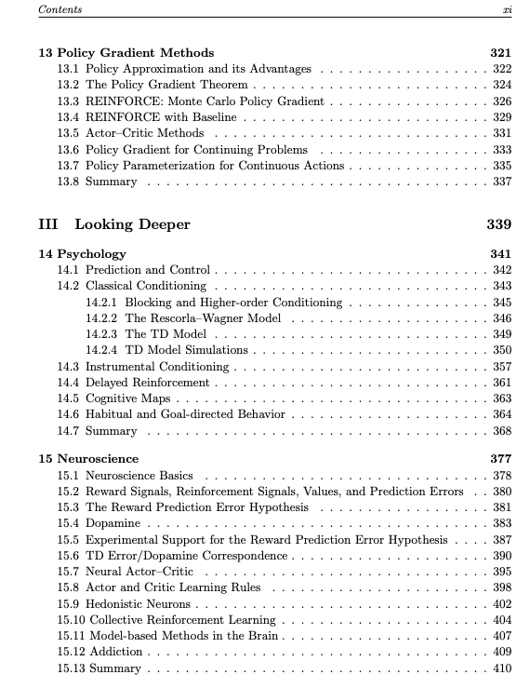
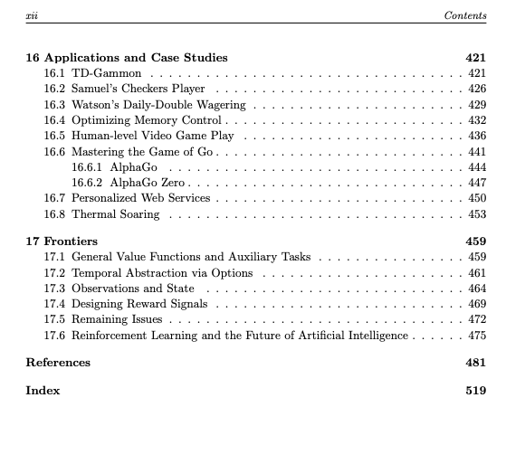

Slide 15

We will follow the flow of this book
We will focus on fundamental RL concepts and classical algorithms that form the backbone of modern RL.
With a solid understanding, we can later explore how these concepts extend to state-of-the-art RL research.

Slide 16
What we won’t cover -- at least not within these weeks
Most Recent RL Papers & Cutting-Edge Applications
We won’t dive into the latest RL papers from NeurIPS, ICML, or ICLR (yet).
No deep dive into RLHF (also DPO, etc) used in LLMs like ChatGPT
We won’t cover advanced multi-agent RL or RL in large-scale real-world applications right away.
Topics like Meta-RL, World Models, or Decision Transformers are beyond our initial scope.
Once we have covered all the important and foundational topics, we can have a new reading session dedicated to interesting RL algorithms! -- probably RL Seminar V3.0

Slide 17
Learning Objectives for Today
RL
RL vs Supervised Learning vs Unsupervised Learning
Elements of RL
Agent, Environment, State, Action
policy, reward, value function, model of the environment

Slide 18
RL
Def: Learning what to do – how to map situations to actions – to maximize a number of reward signals.
“A learning agent must be able to sense the state of its environment to some extent and must be able to take actions that affect the state. The agent also must have a goal or goals relating to the state of the environment. “ (Pp. 24)

Slide 19
RL vs Supervised Learning
Supervised Learning:
Labeled dataset
Goal is to extrapolate, or generalize the prediction correctly to input not in the training set
No interaction with the environment

Slide 20
RL vs Unsupervised Learning
Unsupervised Learning:
No labeled dataset (no supervision)
Goal is to find hidden pattern
No explicit feedback, no planning (Chap. 8)

Slide 21
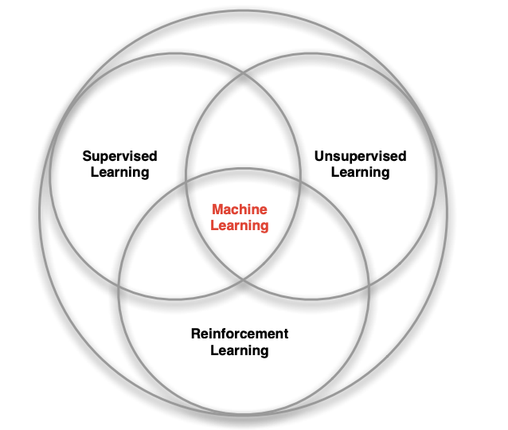
RL is the third machine learning paradigm (pp.24)
Source: David Silver

Slide 22
Exploration vs. Exploitation
To obtain a lot of reward, a reinforcement learning agent must prefer actions that it has tried in the past and found to be effective in producing reward. But to discover such actions, it has to try actions that it has not selected before.
exploit what it already knows in order to obtain reward
explore in order to make better action selections in the future
The dilemma is that neither exploration nor exploitation can be pursued exclusively without failing at the task. The agent must try a variety of actions and progressively favor those that appear to be best. On a stochastic task, each action must be tried many times to gain a reliable estimate its expected reward.

Slide 23
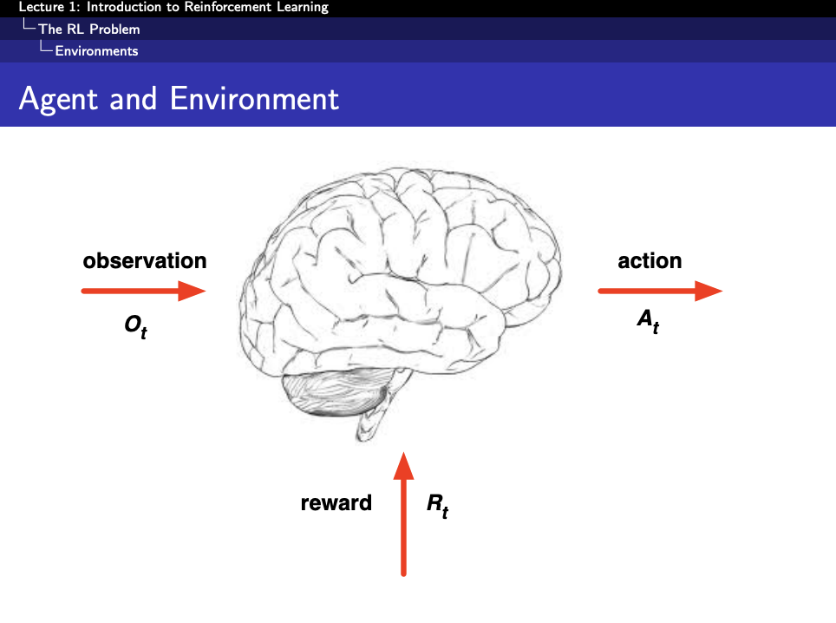
Source: David Silver

Slide 24
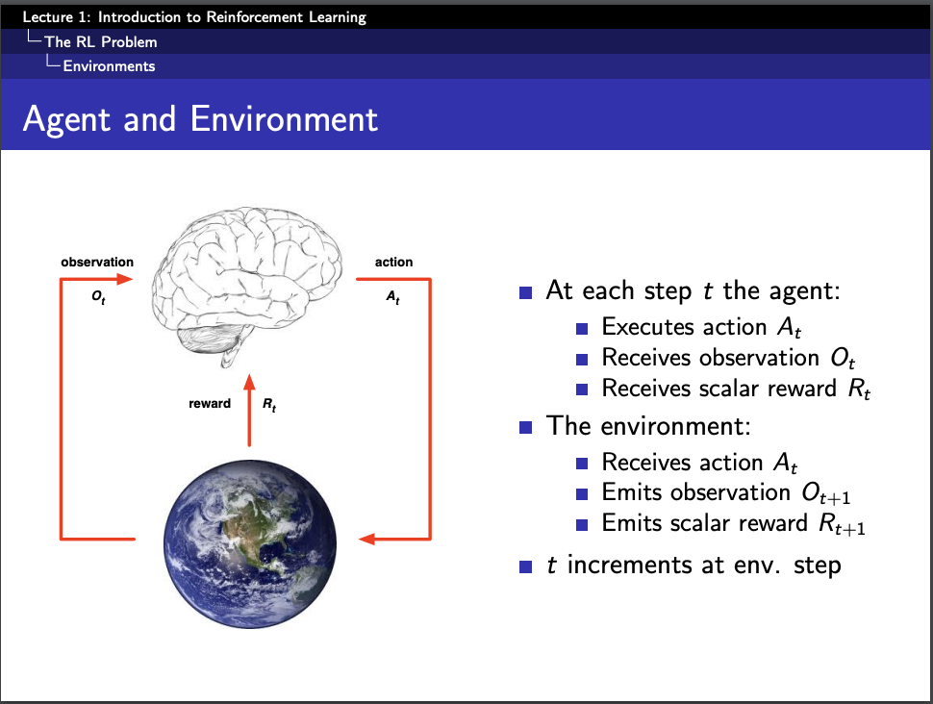
Source: David Silver

Slide 25
Policy: defines the learning agent’s way of behaving at a given time. Roughly speaking, a policy is a mapping from perceived states of the environment to actions to be taken when in those states
Reward signals: defines the goal of a reinforcement learning problem. The agent’s sole objective is to maximize the total reward it receives over the long run. The reward signal thus defines what are the good and bad events for the agent.
Value function: specifies what is good in the long run. – estimated and accumulated long-term reward
In fact, the most important component of almost all reinforcement learning algorithms we consider is a method for efficiently estimating values. The central role of value estimation is arguably the most important thing that has been learned about reinforcement learning over the last six decades. (pp.28)

Slide 26
Model of the environment
“Something that mimics the behavior of the environment, or more generally, that allows inferences to be made about how the environment will behave”. (pp.29)
Models are used for planning – “any way of deciding on a course of action by considering possible future situations before they are actually experienced ”
Model-based: Methods for solving reinforcement learning problems that use models and planning
Model-free: that are explicitly trial-and-error learners—viewed as almost the opposite of planning.

Slide 27
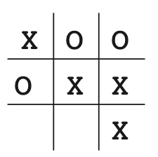
Tic-Tac-Toe example
Simple, well-defined environment Small state space, yet rich enough for learning Demonstrates key RL concepts:
State representation
Action selection
Reward signal
Policy improvement

Slide 28
State: 3×3 board (with X, O, or empty)
Actions: Placing X or O in an empty cell
Transition: Move leads to a new board state
Reward: +1 for a win
0 for a draw
-1 for a loss
Episode Ends: When a player wins or the board

Slide 29
Tic-Tac-Toe as a Dynamic Programming Problem
If the opponent’s strategy is fully known, the game can be formulated as a Markov Decision Process (MDP)
The optimal value function can be computed via Bellman equations
Backward induction or value iteration could be used to solve for optimal moves
Challenge: The opponent’s behavior is not fixed or fully known

Slide 30
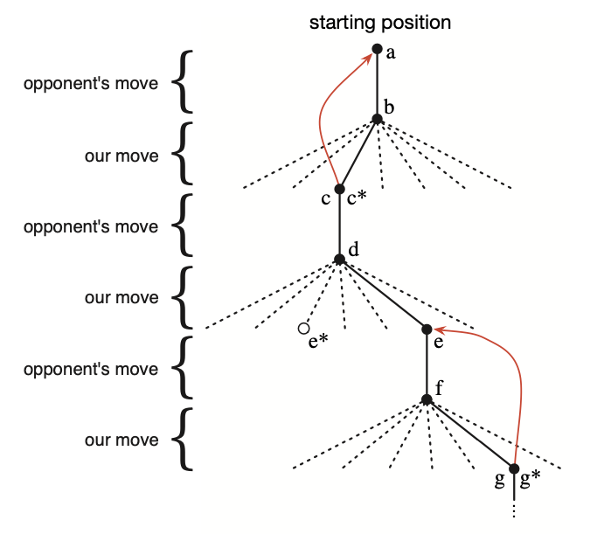
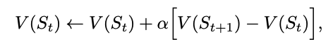
RL for Tic-Tac-Toe
Bold lines: the actual move we take
Dotted lines: all the possible moves we could take
Red: update estimated values
*: best move currently estimated
temporal-difference learning: V(St+1) – V(St)

Slide 31
RL for Tic-Tac-Toe
Model-free methods learn from experience
Exploration allows the agent to adapt to different opponents
The tic-tac-toe player is model-free in this sense with respect to its opponent: it has no model of its opponent of any kind. Because models have to be reasonably accurate to be useful, model-free methods can have advantages over more complex methods when the real bottleneck in solving a problem is the difficulty of constructing a sufficiently accurate environment model. Model-free methods are also important building blocks for model-based methods. (Pp.12)

Slide 32
RL History
Reading

Slide 33
Next Reading and Preparation
Read the chapter by yourself – before meeting
During the seminar, we will walk through important concepts, math equations and proofs together
Read the chapter again – feel the flow!

Slide 34
Other RL Learning Resources
Reinforcement learning Stanford CS234: https://web.stanford.edu/class/cs234/index.html
Deep Reinforcement learning UC Berkeley https://rail.eecs.berkeley.edu/deeprlcourse/
Deep Reinforcement learning Stanford CS224R https://cs224r.stanford.edu/
David Silver: Slides for reinforcement learning at UCL: https://www.davidsilver.uk/teaching/

Slide 35
Famous “School” of RL Work
Sergey Levine, Peter Abbeel, etc (UC Berkeley): Robotics, Planning
Google Deepmind (David Silver): Games, RL Agent, etc
LLM Companies (OpenAI, Deepseek, etc): RL for LLM – RLHF, GRPO, etc

